Slide 1
Medicare, Welfare Fund Benefits:
The Connection
Notes:
Welcome
Recognize Mark, Lois, Cindy & any other dignitary
3. Goal – to show the connection between Medicare & benefits – simple: covers items not covered by Medicare or enhances a Medicare Benefit – For end of presentation…Ask question.

Slide 2



Medicare
Getting Started

Slide 3
The Four Parts of Medicare
Part A
Hospital Insurance
Part B Medical Insurance
Part C Medicare Advantage
Part D Medicare Prescription Drug Coverage
Notes:
Medicare has four parts:
Part A is Hospital Insurance
Part B is Medical Insurance –
Part C is Medicare Advantage which are plans like HMOs and PPOs
Part D is Medicare Prescription Drug Coverage – Premium – High Option Rider – Express Scripts

Slide 4


The Medicare Alphabet (1)
Part A – Hospital Insurance
  Inpatient care in hospitals
  Skilled nursing facility care
  Home health care
  Hospice care
  No Cost
Part B – Medical Insurance
  Doctor’s visits – Medicare pays 80%, Plan pays 20%
  Outpatient hospital services
  Clinical lab tests
  Preventive services (screenings, vaccines, “wellness” yearly visits
  Premium -
Notes:
Days 1–60: $0 coinsurance for each benefit period.
Days 61–90: $408 coinsurance per day of each benefit period.
Days 91 and beyond: $816 coinsurance per each "lifetime reserve day" after day 90 for each benefit period (up to 60 days over your lifetime).
Beyond lifetime reserve days : all costs.
Rest paid by Blue Cross, Blue Shield. $300 deductible within benefit period (60 days). Coverage under Supplemental Medical (up to $750). If second stay is after 60 days of 1st stay, starts day 1 again.
Hospital inpatient care - Semi-private room, meals, general nursing, and other hospital services and supplies. Includes care in critical access hospitals and inpatient rehabilitation facilities. Inpatient mental health care in a psychiatric hospital (lifetime 190-day limit).
Skilled nursing facility (SNF) care (not custodial or long-term care) when certain conditions are met. Your costs in Original Medicare
You pay:
Days 1–20: $0 for each benefit period.
Days 21–100: $204 ($194.5 in 2023) coinsurance per day of each benefit period. (no pay if in GHI senior care)
Days 101 and beyond: all costs.
Covered 100 days in senior care plan
Home health care - A doctor enrolled in Medicare, or certain health care providers who work with the doctor, must see you before the doctor can certify that you need home health services. That doctor must order your care, and a Medicare-certified home health agency must provide it. You must be homebound, which means that leaving home is a major effort. You pay nothing for covered home health services.
Hospice Care - For people with a terminal illness. Your doctor must certify that you are expected to live 6 months or less. Coverage includes drugs for pain relief and symptom management; medical, nursing, durable medical equipment for pain relief and symptom management; and social services; and other covered services as well as services Medicare usually doesn’t cover, such as grief counseling.
Blood - If the hospital gets blood from a blood bank at no charge, you won’t have to pay for it or replace it. If the hospital has to pay for it, you have to pay for the first 3 units you get in a calendar year or have someone donate it.
Doctors’ Services - Services that are medically necessary.
Outpatient Medical and Surgical Services and Supplies - For approved procedures (like X-rays, a cast, or stitches). You pay the doctor 20% of the Medicare-approved amount for the doctor’s services. You also pay the hospital a copayment for each service you get in a hospital outpatient setting. For each service, the copayment can’t be more than the Part A hospital stay deductible. The Part B deductible applies, and you pay all charges for items or services that Medicare doesn’t cover.
Home Health Care Services
Durable Medical Equipment
Preventive Services like exams, lab tests, screening and shots to help prevent, find, or manage a medical problem. Preventive services may find health problems early when treatment works best.
Medicare Part B – Part B generally pays 80% of out-of-pocket costs, participants pay 20% and some purchase supplement plans. However NYC municipal retirees do not have to purchase additional coverage as their city plan becomes the supplement (GHI) automatically.
Premiums: Standard vs Irmaa – Income-related-monthly-adjustment-amount

Slide 5

The Medicare Alphabet (2)
Part C
  Another way to obtain Medicare known as Medicare Advantage Plans
  Offered by private companies that provide both Part A (hospital) and Part B (medical) insurance
  Act as HMO or PPO
Part D
  Drug Plan –
  Must have Parts A & B
  Late Enrollment Penalty
  Premium –
Notes:
PPO – Preferred Provider Organization.
HMO – health Management Organization
A Medicare Advantage Plan is a type of Medicare health plan offered by a private company that contracts with Medicare to provide all your Part A and Part B benefits. Most Medicare Advantage Plans also offer prescription drug coverage
Part D – drug coverage – paid for by your high option rider.

Slide 6
What’s New in 2026 Summary
Medicare’s mental health coverage expanded.
Part B & Part D premiums increased.
Part B deductible increased.
$2,100 cap on cost of drugs if you have a drug plan. Insulin capped at $35. Option to spread costs over year. 2027 cap is $2,400
Expanded telehealth coverage. Services extended to 2027.
Prior authorization changes in 6 states still operating.
Lower prices for 10 negotiated drugs start.

Slide 7
How Much Do I Pay for 2026 Senior Care? (Traditional Medicare +Emblem Health)
Part A – Nothing
Part B – Depends on income
  Standard - $ 202.90 in 2026 ($185 in 2025)
  Income-Related Medicare Adjustment Amount (IRMAA )
  Both Standard & IRMAA Costs Reimbursed
  Deductible - $283 + $50 – Not Reimbursable ($257 + $50 in 2025) +
  Copays - $15.
  No Max Out-of-Pocket Cost
Part D –
  Monthly Premium (High Option Rider - $180 up $30) Surcharge
  Co-pays – Max $2,100
  Reimbursed $40 per month for each month in previous year. (Valentine Day Check – max of $480) by Welfare Fund. Only for member
  Express Scripts – Network Pharmacy through December 31, 2025. Starting January 1, Prime Therapeutics.
Notes:
Medicare has two parts, Part A (Hospital Insurance) and Part B (Medicare Insurance). You are eligible for premium-free Part A if you are age 65 or older and you or your spouse worked and paid Medicare taxes for at least 10 years.
Part D - $40 per month. Only for member. Gift from CSA. Surcharge started in 2011. Fund Benefit enhancing Plan D
Irmaa – contractual benefit

Slide 8
Medicare Part B Surcharges - 2026
Premium Adjustments Based on 2024 Tax Returns
2024 Individual Tax Return | 2024 Joint Tax Return . | IRMAA | total monthly premium
$109,000 or less | $218,000 or less | $ 0.00 | $202.90
$109,000,01 to $137,000.00 | $218,001.01 to $274,000.00 | $81.20 | $284.10
$137,000.01 to $171,000.00 | $274.000.01 to $342.000.00 | $202.90 | $405.80
$171,000.01 to $205,000.00 | $342,000.01 to $410,000.00 | $324.60 | $527.50
$205,000.01 to $499.999.99 | $410,000.01 to $7,499,999.99 | $446.30 | $649.20
Above $500,000 | Above 750,000 | $487.00 | $689.90
8
NY City (OLR) reimburses Part B including IRMAA

Slide 9
Medicare Part D Surcharge - 2026
Premium Adjustments Based on 2024 Tax Returns
2024 Individual tax return | 2024 Joint tax return | IRMAA
$109,000 or less | $218,000 or less | $00.00
$109,000,01 to $137,000.00 | $218,001.01 to $274,000.00 | $14.50
$137,000.01 to $171,000.00 | $274.000.01 to $342.000.00 | $37.50
$171,000.01 to $205,000.00 | $342,000.01 to $410,000.00 | $60.40
$205,000.01 to $499.999.99 | $410,000.01 to $7,499,999.99 | $83.30
Above $500,000 | Above 750,000 | $91.00
NY City (OLR) does not reimburse Part D IRMAA

Slide 10
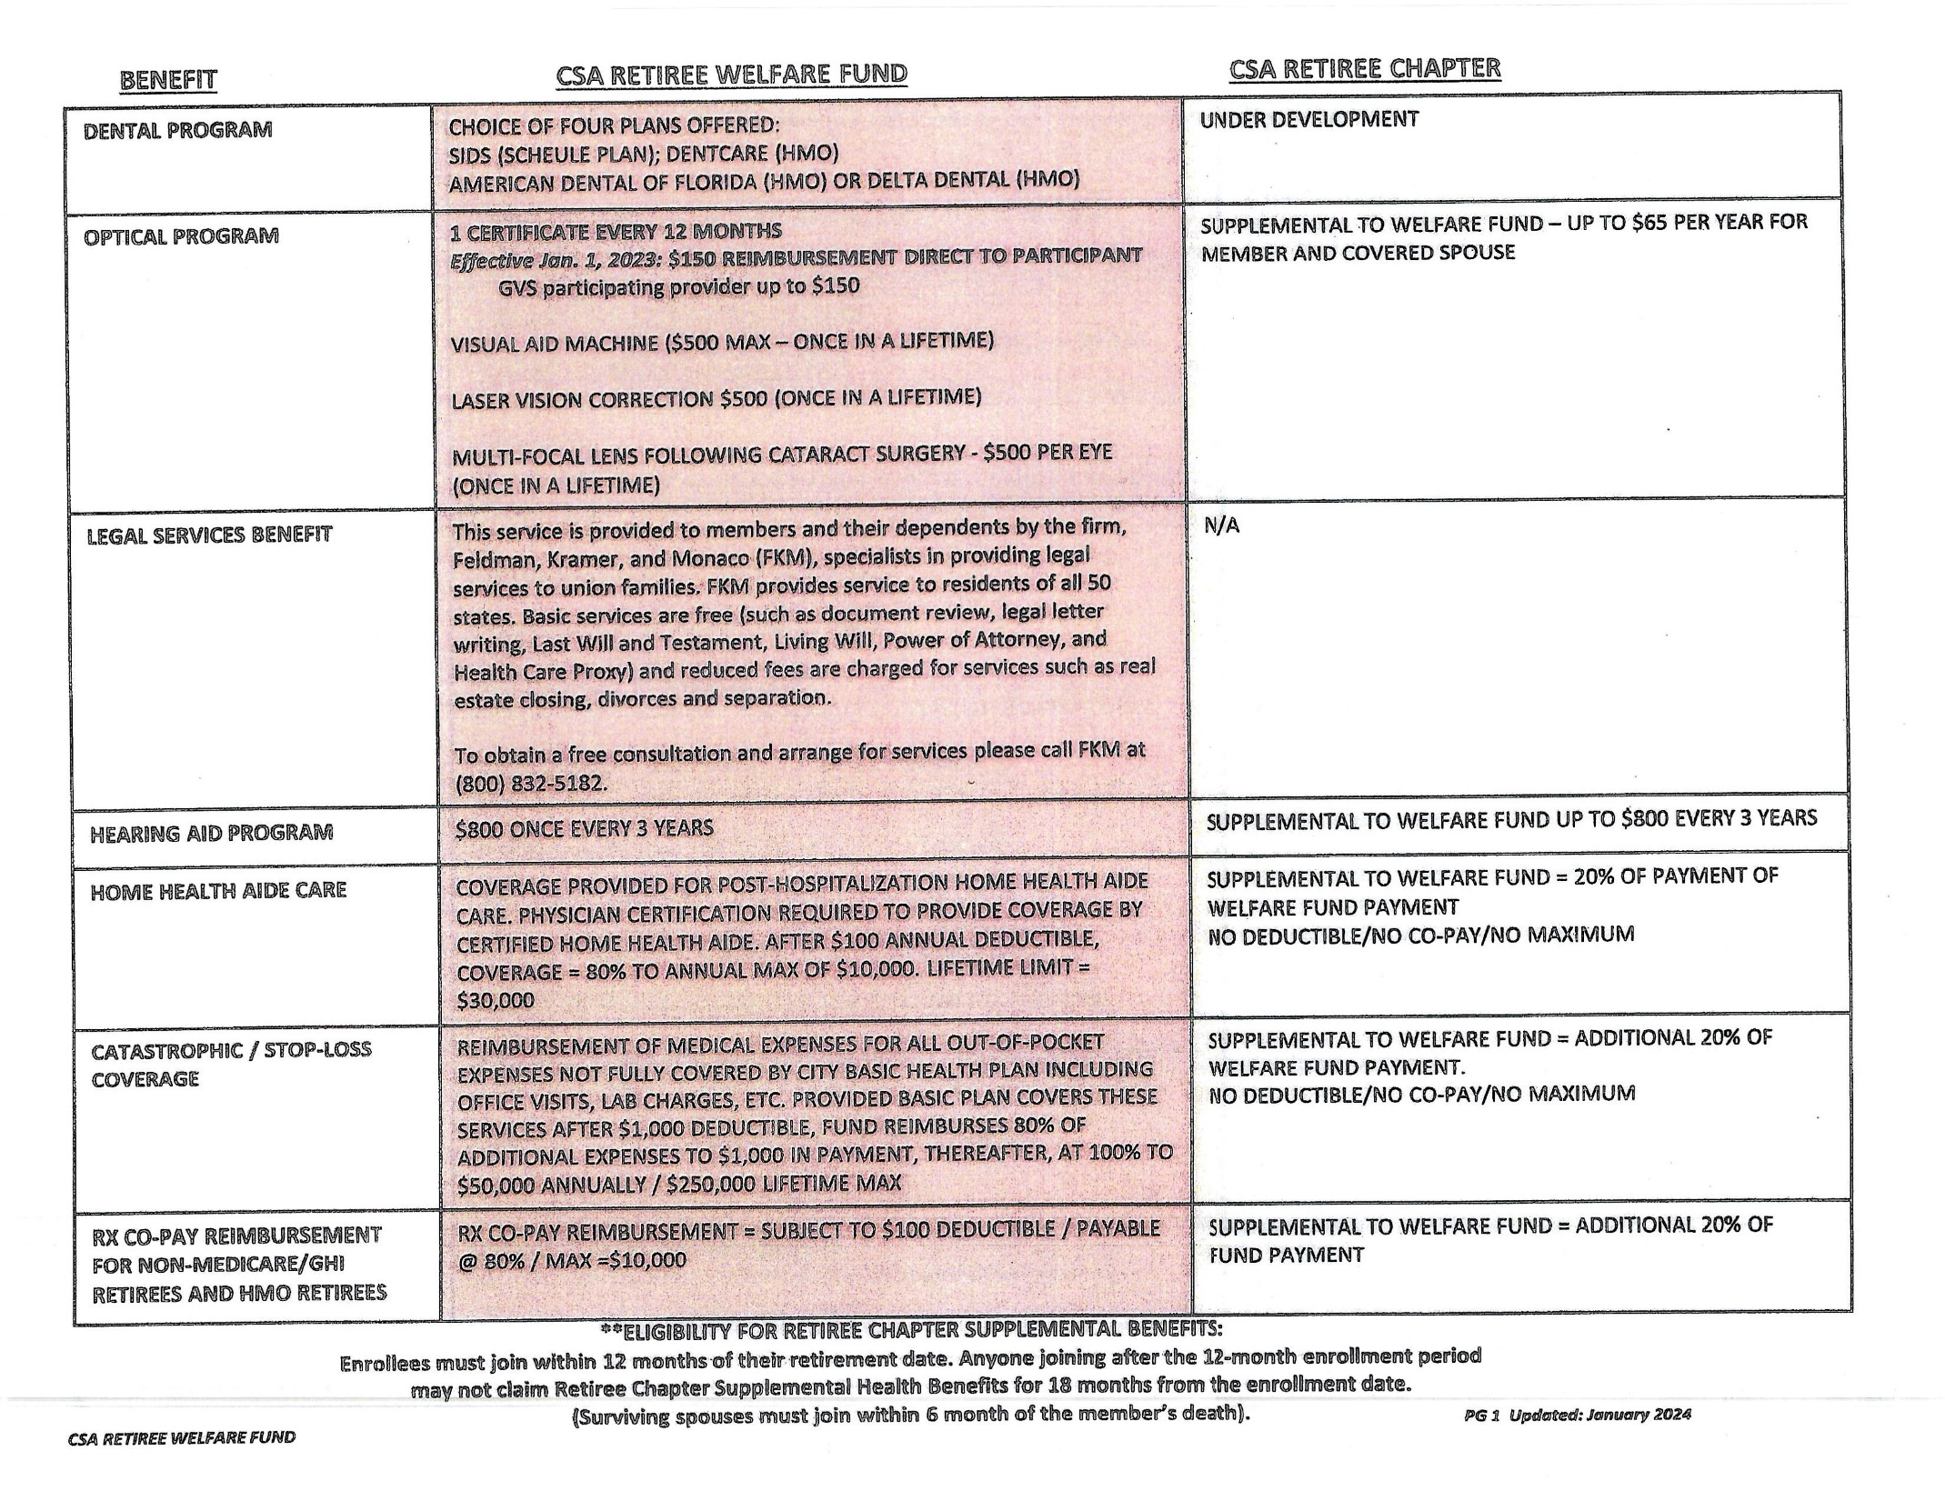

Slide 11
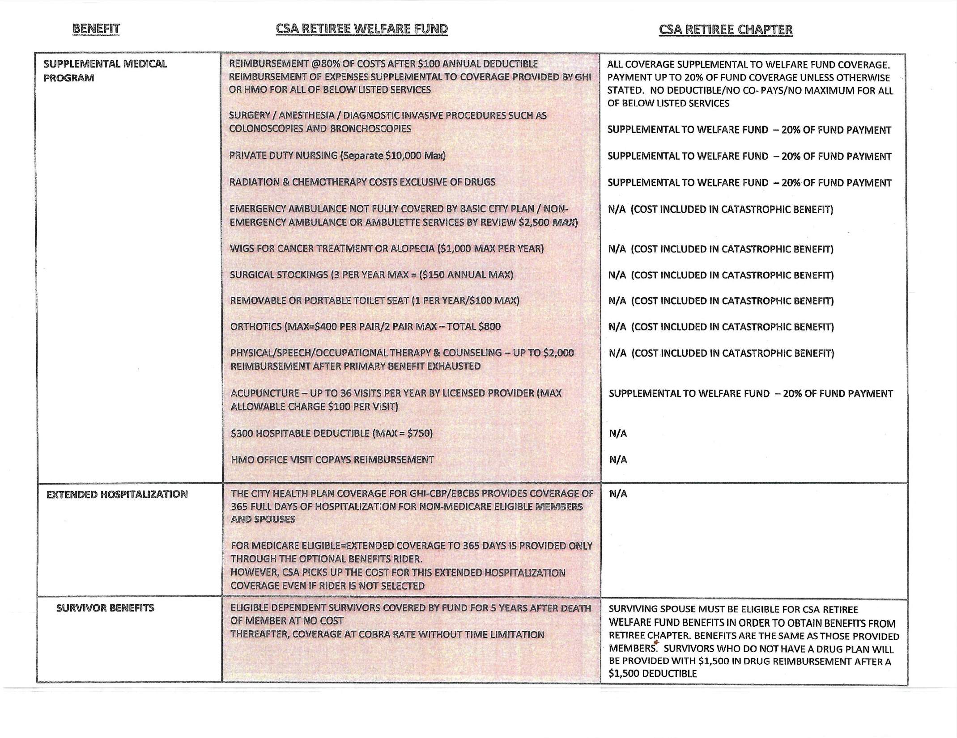

Slide 12
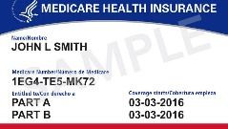
How do I Enroll?
Receive Medicare card 3 months before 65th birthday, if receiving Social Security. Submit a signed copy along with Medicare Card Transmittal Form (download from CSAWF website) to the Office of Labor Relations.
If not on Social Security, need to apply for Part A & B. You can apply online, www.ssa.gov.
Enrolled in Part D – GHI Drug Plan – through High Option Rider
Notes:
If you are already receiving Social Security benefits (for example, getting early retirement) you will be automatically enrolled in Medicare Part A and Part B without an additional application. You will receive you Initial Enrollment Period Package, which includes your Medicare card and other information, about 3 months before age 65 (coverage begins the first of the month you turn 65), or 3 months before your 25th month of disability benefits (coverage begins your 25th month of disability benefits).
Welcome to Medicare, CMS Product No. 11095 is pictured on this slide. It is part of the Initial Enrollment Period Package.
Send copy of signed card & transmittal form to OCR

Slide 13

More Information
Medicare & You Handbook 2026
1-800-MEDICARE
Medicare Rights : medicarerights.org
Guide to Medicare Products: medicare.com
Official Govt Site for Medicare: medicare.gov
NYC Medicare Advantage Plus Enrollment Guide
Notes:
More information and help is available:
The Medicare & You handbook is mailed to each household with Medicare yearly in the fall. It includes the Part C and Part D plans in your area.
Other publications are available on www.medicare.gov.
The Medicare helpline is open 24 hours a day including weekends. Call 1-800-Medicare (1-800-633-4227). TTY users call 1-877-486-2048.
Partners can find information from the National Medicare Training Program at www.cms.hhs.gov/NationalMedicareTrainingProgram
Contact your State Health Insurance Assistance Program (SHIP). Their phone number is on the back cover of your Medicare & You handbook, or get it under helpful contacts on www.medicare.gov.
NOTE: Presenters may wish to add local contact information.

Slide 14
Q & A
Q. Do you need to take a Medigap Insurance plan?
A. No. If you are on Traditional Medicare, Emblem Health is your secondary. If you are on the Medicare Advantage Plus Plan, you need nothing else.
Q. If you are not receiving SS, how do you pay Medicare Part B?
A. SS sends you a bill.
Notes:
Ask what is the connection

